Slide 1



Java basics
Session
4
Chaim Turkel
Ido Barash

Slide 2


Last session
Exceptions
Collections interfaces
Iterators

Slide 3
Java basics - 4
Generics

Slide 4

Generics
Allows abstraction of classes over Types. For example: Collections: Collection of <Type>
Enables compiler enforce type safety. Moves error checking from run time to compile time.
Improve readability.
Generic class is also called “Parameterized class”

Slide 5
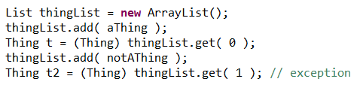
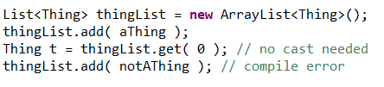
Generics
Before Java 1.5:
After Java 1.5

Slide 6
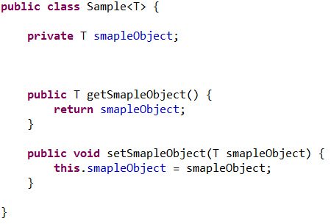
Generics
Defining a generic class:

Slide 7


Generics
Creating an empty constructor:
Creating a parameters constructor:
can use the class’s type parameter as the type of the constructor parameters. Instantiate a generic class:

Slide 8
Generics
Sometimes it makes sense to restrict the possible types that can be used as a type parameter: In this case, Sample can only be used with objects that implements comparable interface.
A restricted type can contain multiple interfaces and up to one class.

Slide 9

Generics
Methods can also be generics.
A generic method can either use the parameter type of the class or define it’s own
A generic method can be a member of an ordinary class (not parameterized.
A type parameter of a method is local to the method and not to the class.

Slide 10
Generics
Sometime we know that a collection will have a parameter type but we just don’t know what it is write now.

Slide 11
Generics
Sometime we know that a collection will have a parameter type but we just don’t know what it is write now.
We could use but this declares a list of all objects and not a list of a specific type.

Slide 12
Generics
Sometime we know that a collection will have a parameter type but we just don’t know what it is write now.
We could use but this declares a list of all objects and not a list of a specific type.
Generic wildcards: This declares a list of a specific type – one specific type.

Slide 13
Generics
Wildcards can have restrictions just as generic types:
Wildcards can also restrict a type and it’s super types:
With “extends” keyword: the list will accept the Base type and all of it’s sub-classes.
With “super” keyword: the list will accept the Base and all of it’s super-classes.

Slide 14
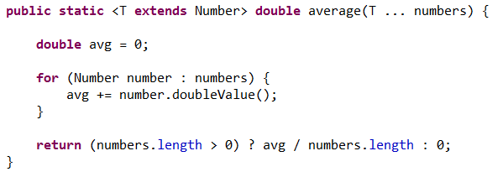
Generics
Exercise: Write a generic method that gets some type extending Number and returns the average.

Slide 15
Generics
Exercise: Write a generic method that gets some type extending Number and returns the average.

Slide 16
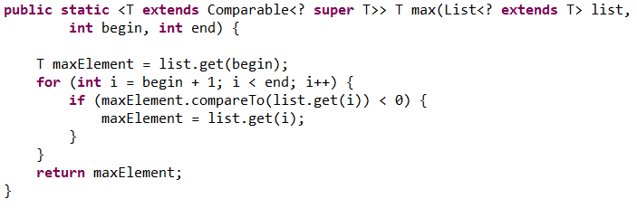
Generics
Exercise: Write a generic method that to find the maximal element in range of a collection

Slide 17
Generics
Exercise: Write a generic method that to find the maximal element in range of a collection

Slide 18
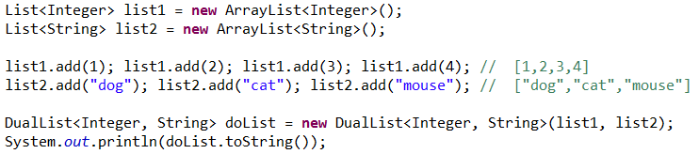
Generics
Exercise: Write a parameterized DuaList class which contains two lists of two different types.
Write a method toString thats returns string representation of both lists as one with “→” delimiter using iterators. End of list will be marked as “||”

Slide 19
Overview
Generics

Slide 20


THANK YOU
Ido Barash
Email: ido.barash@tikalk.com

